Slide 1
Casing Design
Casing Setting Depth and Well Sizing

Slide 2
Course Objectives
Identify the principal function of casing in a well
Identify the casing string that provide structural support the wells and how loads are spread across the casing string
Identify the factors that determine the minimum setting depth of casing
Highlight the differences between top down and bottom-up casing seat selection
Perform top down casing seat selection given information about formation strength and pore pressure

Slide 3

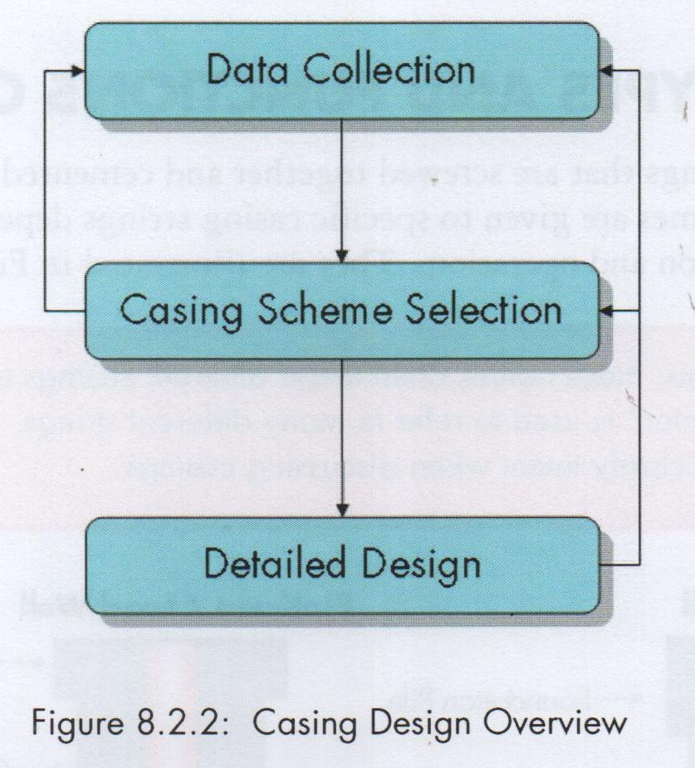
Casing Design Overview
Preliminary casing design has two principal deliverables:
Casing Sizes (Ods)
Casing Setting depths
Key important data for casing design
Location → Onshore, Offshore, Swamp, Deep water
Formation type and behaviour
Pore Pressure & Fract Pressure
Temperature Profile

Slide 4
Casing-shoe setting depth considerations
To isolate overlying unstable formations
To isolate overlying shallow hydrocarbons
To isolate overlying lost-circulations zones
To isolate overlying freshwater horizons
To prevent borehole failure by time-dependent chemical instability from prolonged exposure to drilling fluid
To prevent failure of formations by induced circulating pressure during drilling operation such as circulating, drilling, and tripping
To prevent failure of formations by induced circulating pressure during well control operations when closing in and circulating out an influx

Slide 5
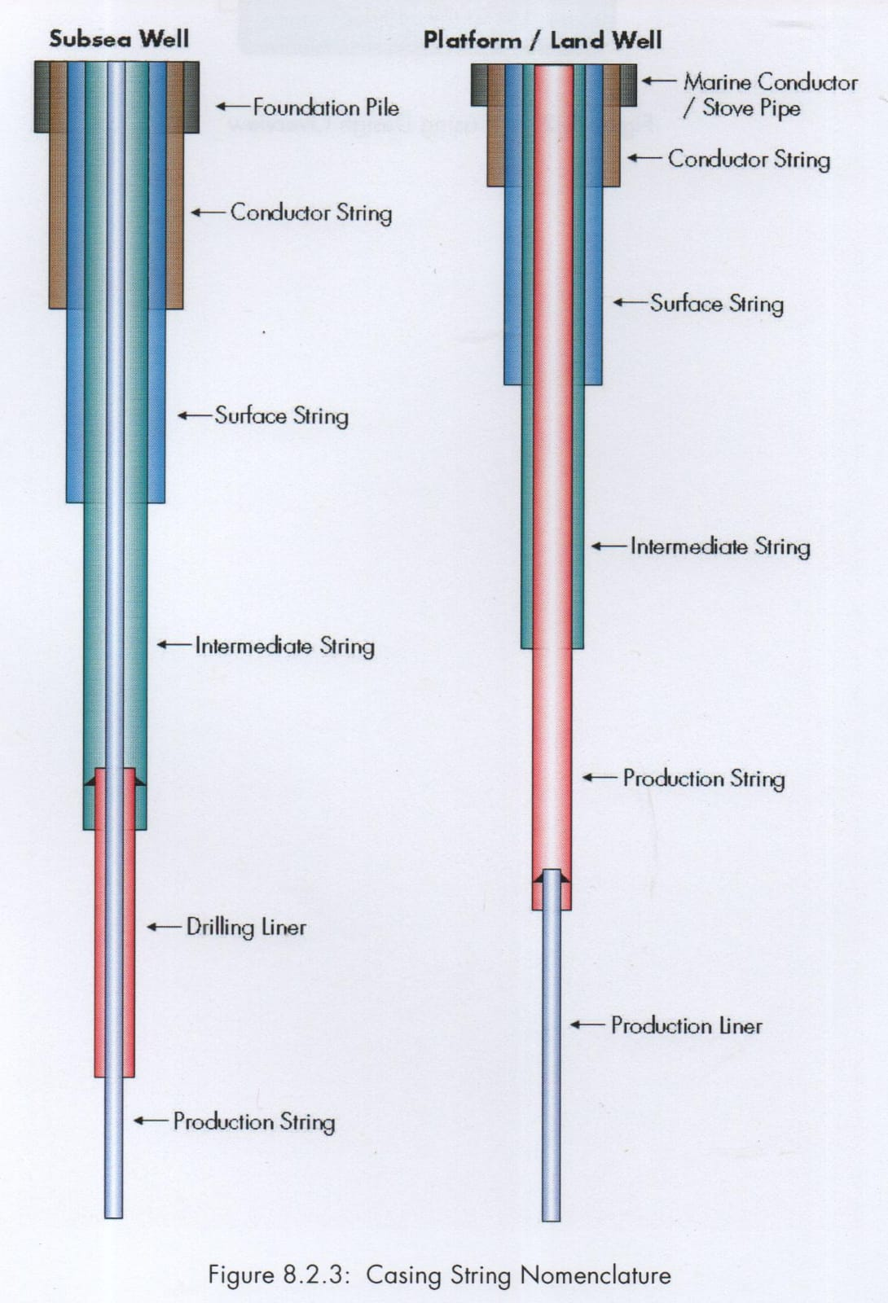
Type and Function of Casing
Conductor/Foundation
Surface Casing
Intermediate Casing
Production Casing
Production Liner
Production String/Tubing

Slide 6
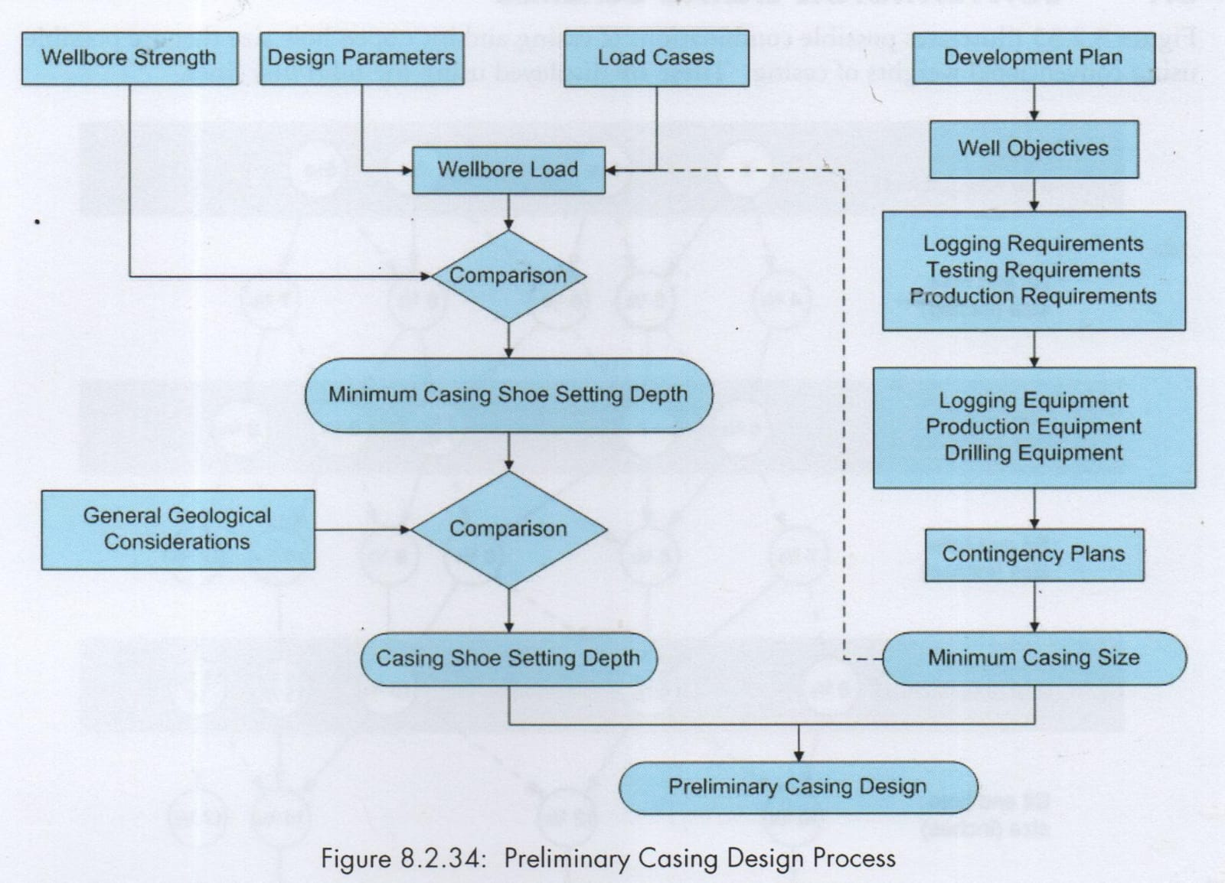
Casing Design Process
Key Design Process:
Design Parameter
Load Case
Wellbore Strength
Development Plan

Slide 7
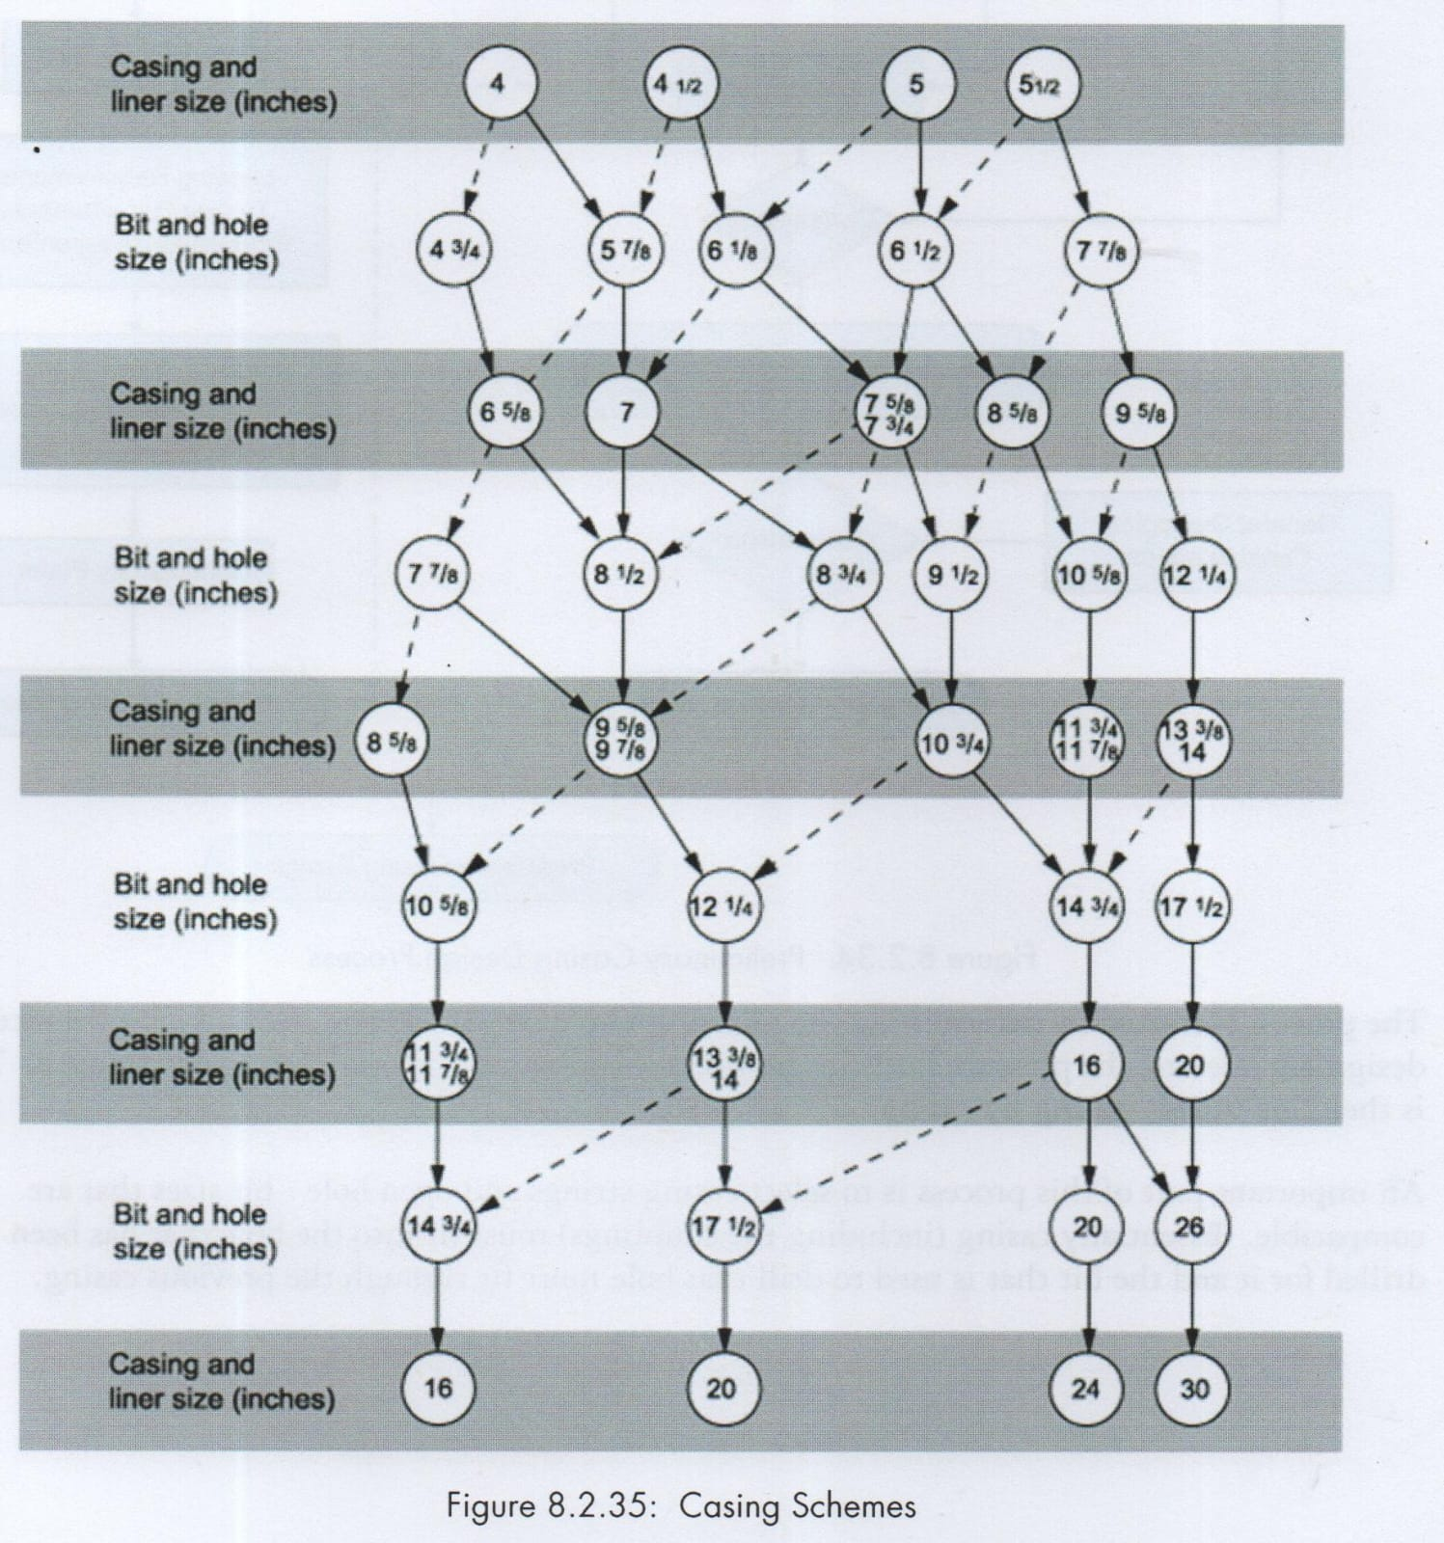
Casing Scheme Selection
Locate either the final hole size or final casing size for completion
From each casing and hole size, follow solid line for conventional size or dash line for special size and clearance
Ensure the requirement of hole enlargement or bi-center for special clearance to accommodate cementing annulus quality

Slide 8
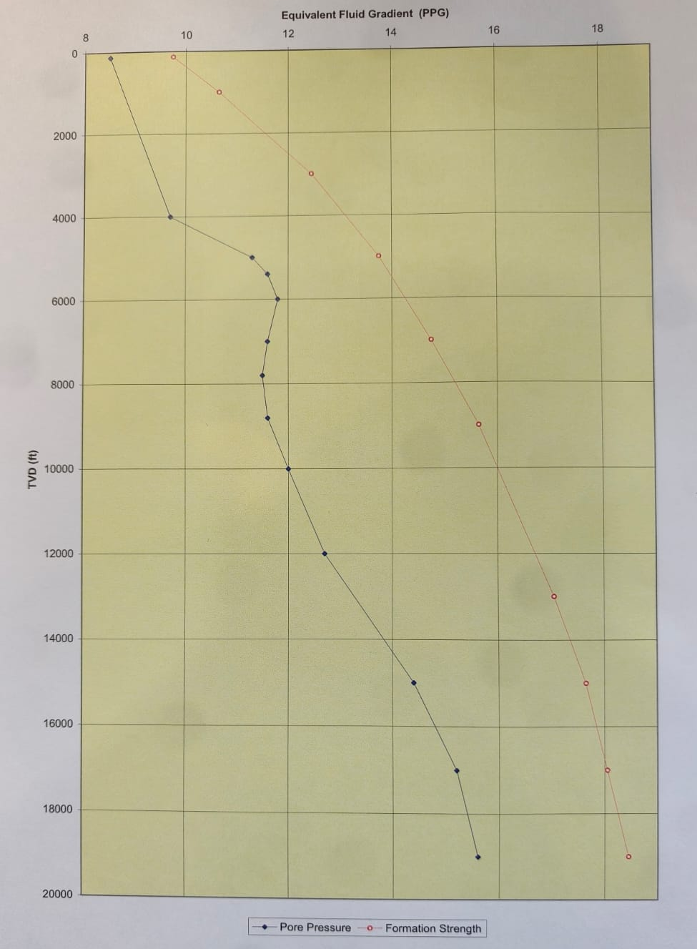
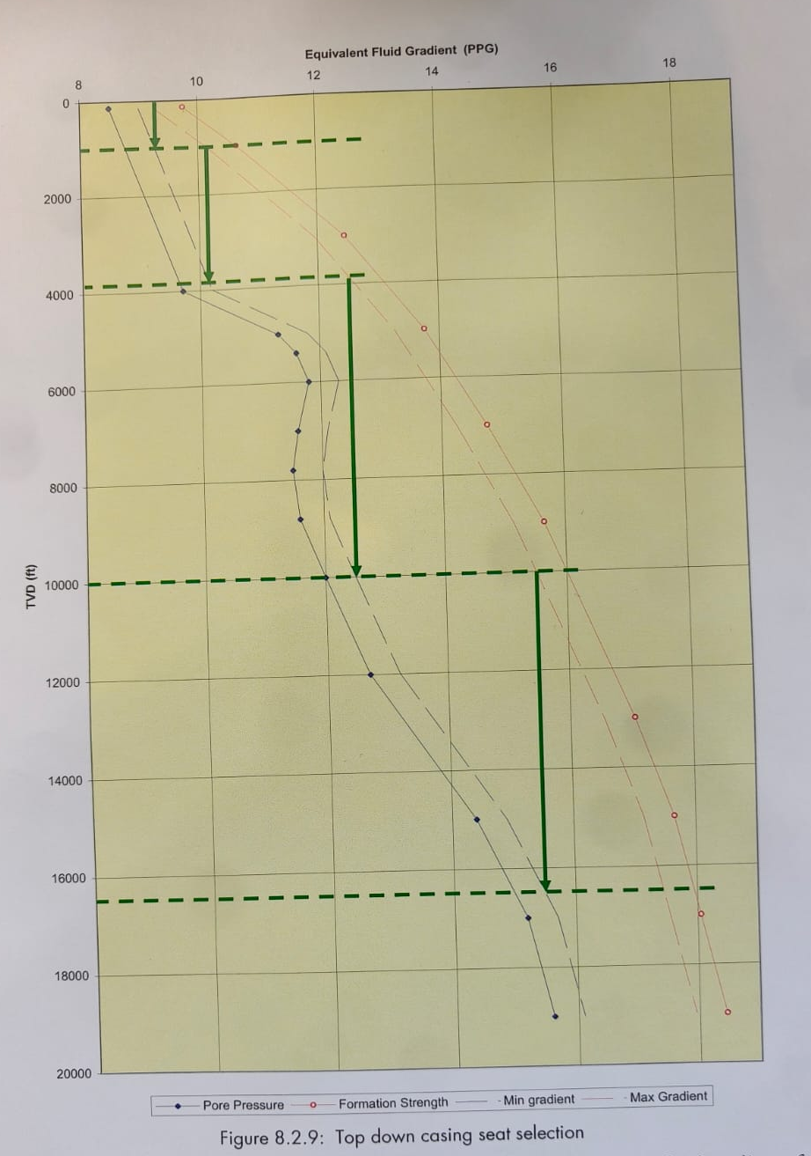
Top Down Methode

Slide 9
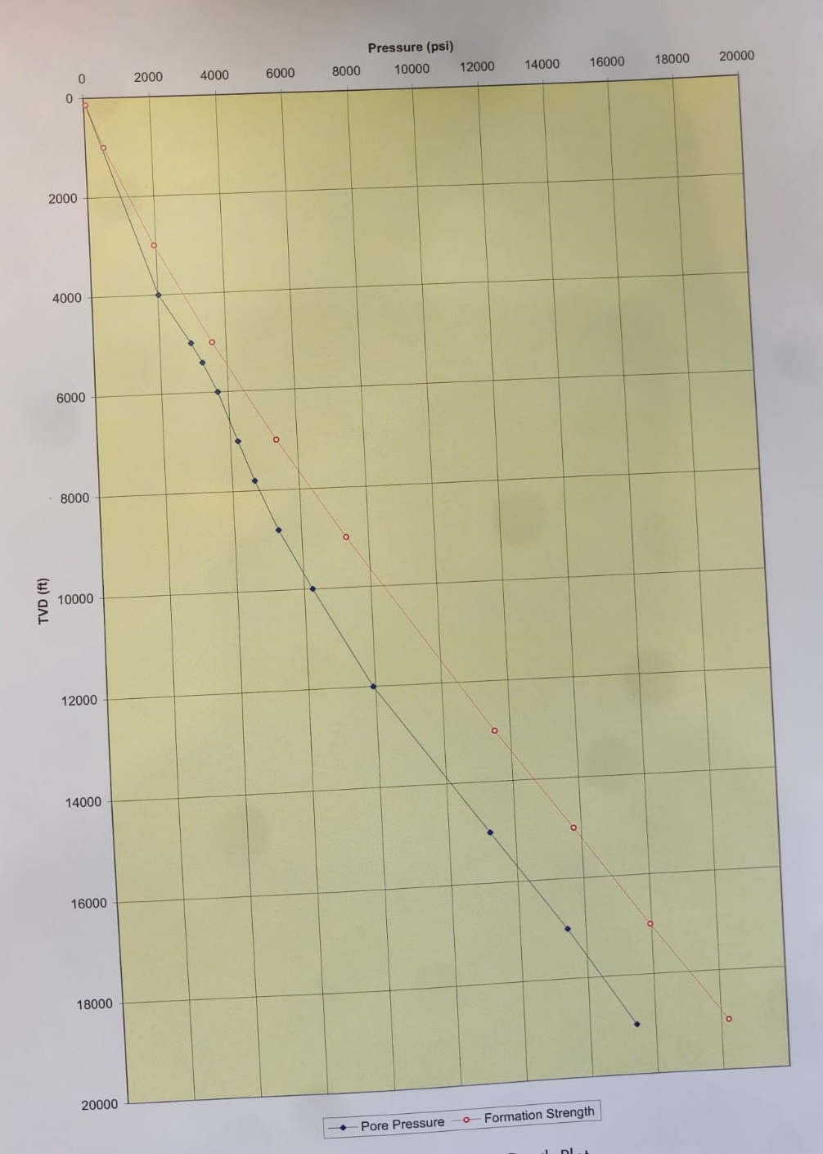
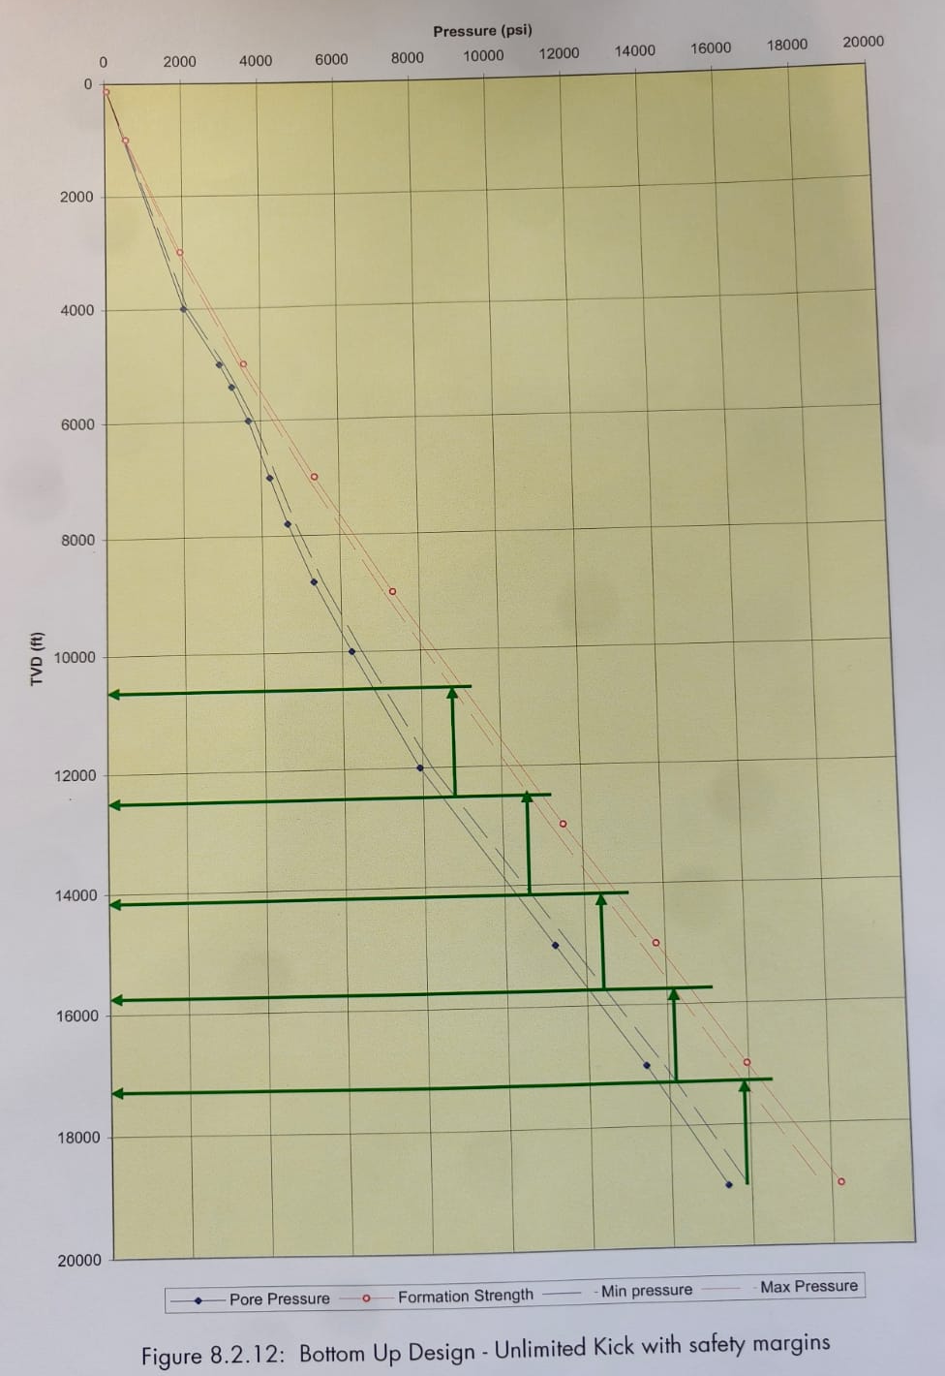
Bottom Up /
Unlimited
Kick
Methode

Slide 10
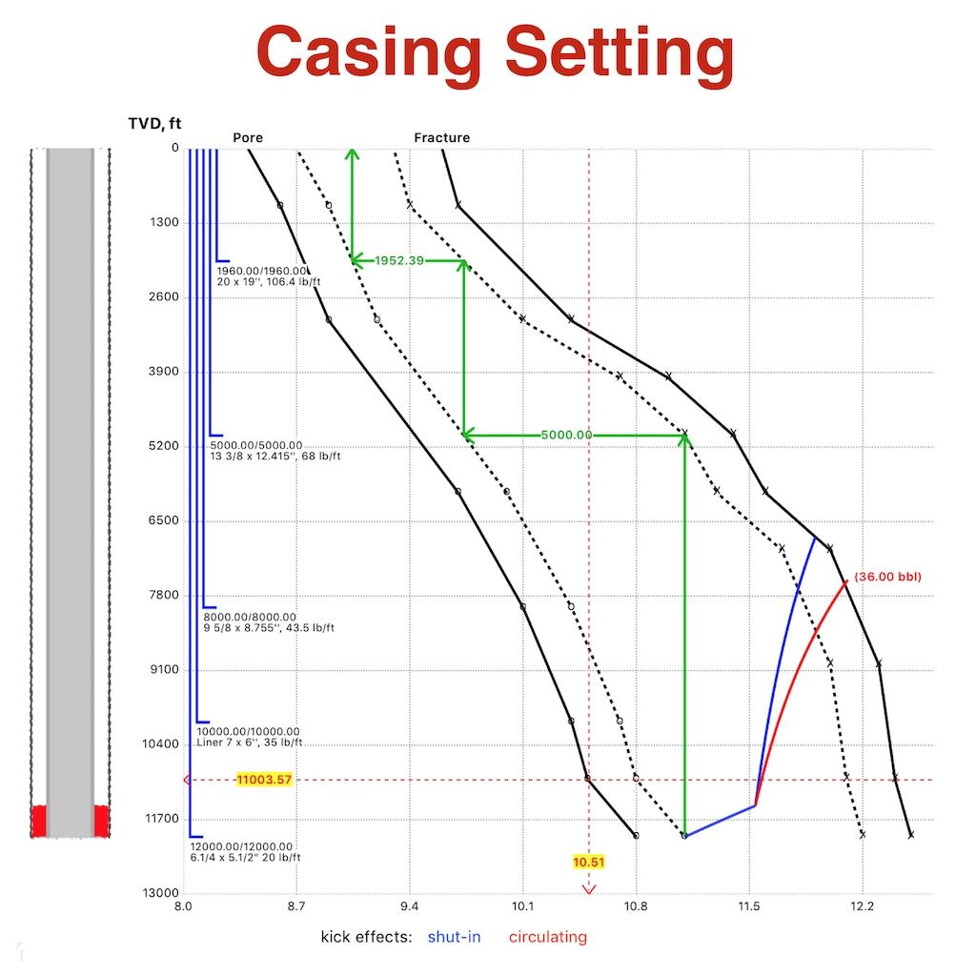
Casing Seat Selection
Pressure Plot → Pore & Frac Pressure vs Depth
Full evacuation (kick)
Trip Margin
Formation type
Subsurface risk
Offset Wells

Slide 11
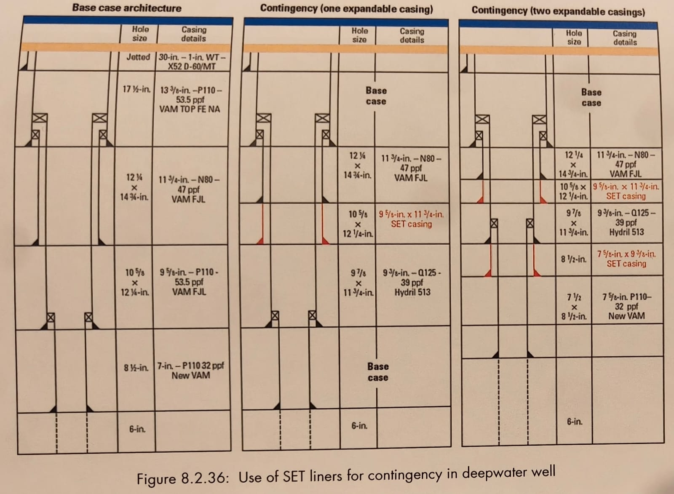
Casing Expandable Application
Contingency String
Keep the final hole/casing size as per plan
Tight tolerance for next section
Required hole enlargement

Slide 12
Calculation Example
TVD (ft) | Pore Pressure (psi) | Fracture Pressure (psi)
1000 | 442 | 530
1300 | 588 | 693
2200 | 1030 | 1236
3000 | 1420 | 1700
3300 | 1579 | 1973
4500 | 2176 | 2995
6200 | 3063 | 4352
7000 | 3822 | 4732
8200 | 4477 | 6396
8200 | 5202 | 6396
12000 | 7675 | 9984
12000 | 8798 | 9984
12800 | 9452 | 10783
13000 | 9667 | 11019
Determine the casing setting depth that would be required when performing a top down casing seat selection process. Maintain 0.5 ppg margin above the pore pressure and a 0.75 ppg margin below the formation strength pressure
Determine the casing setting depth if performing a bottom-up casing seat selection process. Apply a degree of kick tolerance by maintaining a margin of 200 psi above the expected pore pressure and a 100 psi margin below the formation strength pressure
What is the casing scheme if the final section in the reservoir required 7” liner casing and cemented (used the conventional sized as much as possible)

Slide 13
Thank You

